Slide 1


ZkLogin-based Membership Subscription Platform
Integrating Deposit, Lottery, and Subscription Functions
by Ray

Slide 2








Product Overview
One-Click Login
Account Deposit
Google one-click login, automatically generating zkLogin blockchain identity
Select amount, on-chain smart contract mints USDT
Account Lottery
Subscribe to Membership
Participate in lottery, win different amounts of SUI tokens
Choose plan, obtain membership identity

Slide 3

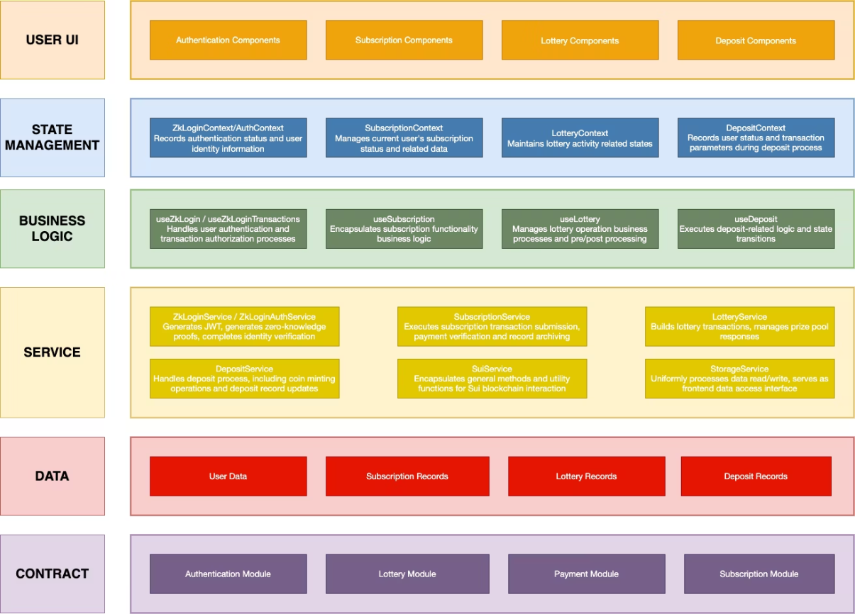
System Architecture

Slide 4
System Interaction Logic
Vertical Interaction Flow
Horizontal Integration
Frontend to Blockchain Path: User operations trigger UI component events Components call Context global state methods Context executes relevant Hook business logic Hook calls Service methods Service builds transactions and calls blockchain contracts Blockchain to Frontend Path： Blockchain executes transactions and emits events Service layer monitors/queries blockchain state Data is passed through Hook to Context Context updates global state UI components respond to state changes and update interface
Cross-Module Collaboration:
Authentication system provides identity verification for all other modules
Deposit system provides financial foundation for subscription and lottery
Data Synchronization Mechanism：
On-chain data as authoritative data source
Off-chain database stores user details and transaction history
Regular synchronization ensures data consistency
State Management Strategy:
Immediate state: React Context memory management
Session state: sessionStorage temporary storage
Persistent state: localStorage long-term cache
Permanent state: Blockchain immutable storage

Slide 5




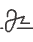


Authentication System
Transaction Signing
Use temporary keys and partial signatures to generate complete signatures, submit transactions to sui chain
User Login
Obtain JWT token from OAuth provider, generate zkproof and zkLogin address
Identity Verification
Verify user permissions, confirm user identity matches operations

Slide 6

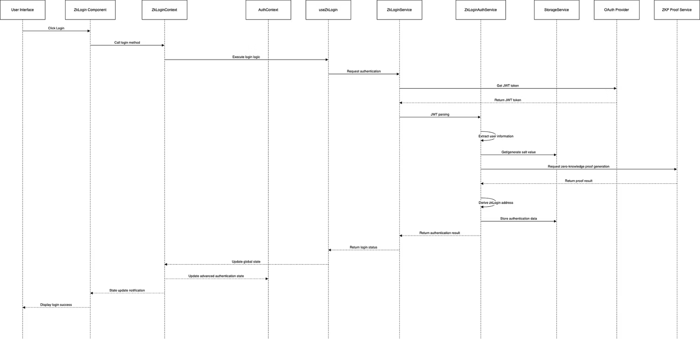
Authentication System-User Login
Involved Modules
State Persistence
Frontend Components: /components/zklogin/
JWT Token: Stored in localStorage, with expiration time
State Management: ZkLoginContext.tsx, AuthContext.tsx
User Salt Value: Stored in localStorage or database
Business Logic: useZkLogin.ts, useZkLoginParams.ts
Temporary Key: Stored in session storage (sessionStorage), automatically cleared when session ends
Service: ZkLoginService.ts, ZkLoginAuthService.ts
Authentication State: Saved in memory via ZkLoginContext, restored from storage service after page refresh
External Dependencies: OAuth Provider, ZKP Proof Service

Slide 7

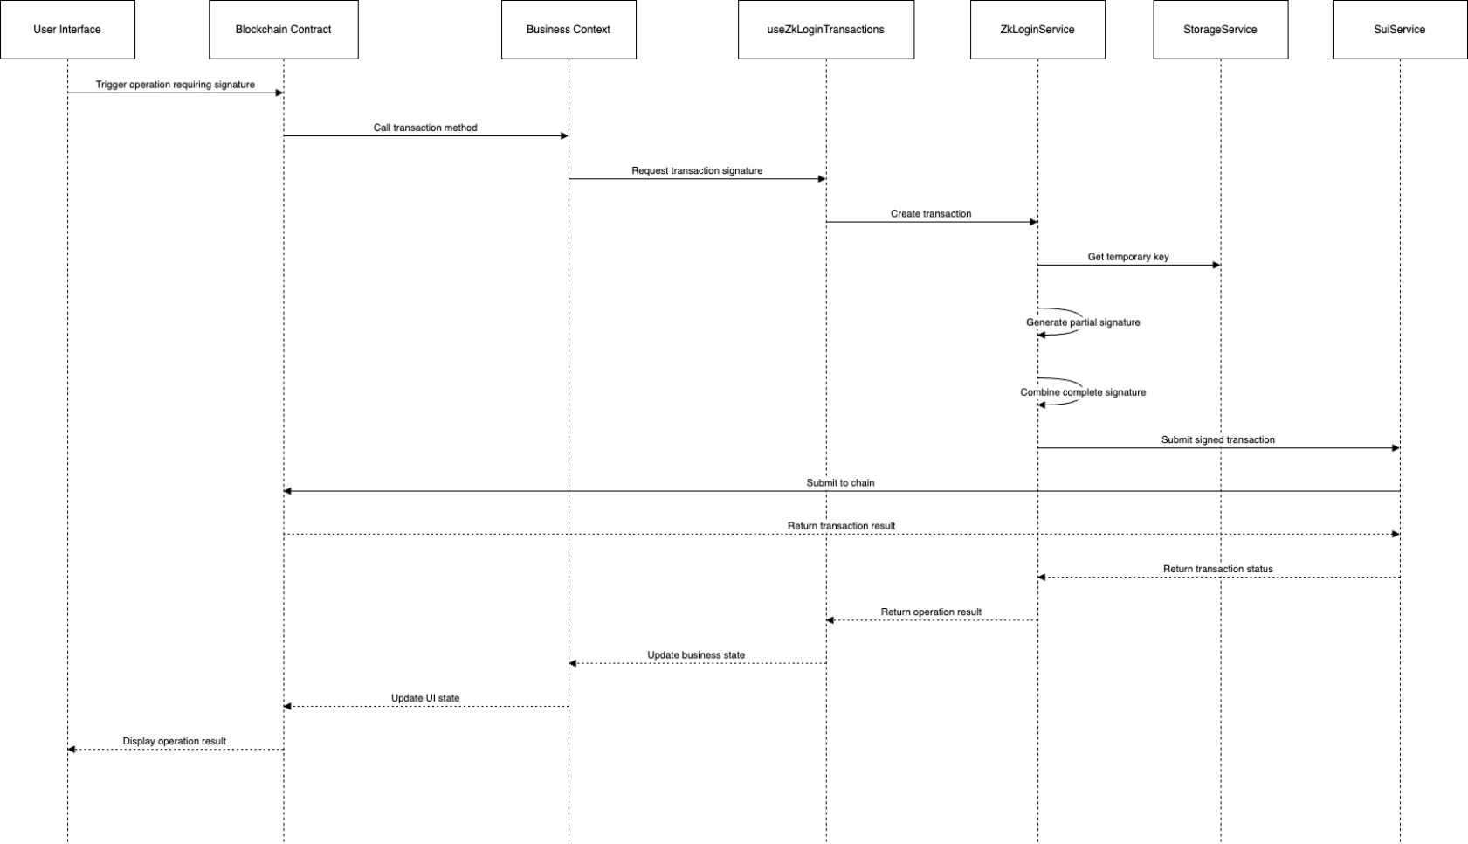
Authentication System-Transaction Signing
Involved Modules
State Persistence
Business Components: Subscription/Lottery/Deposit components
Temporary Key: Temporarily stored in session storage
Business Logic: useZkLoginTransactions.ts
Transaction Data: Temporarily stored in memory
Service: ZkLoginService.ts, SuiService.ts
Transaction Result: Saved on the blockchain, may also be cached in the frontend
Blockchain Contracts: authentication.move
Transaction State: Briefly saved in memory via ZkLoginContext

Slide 8

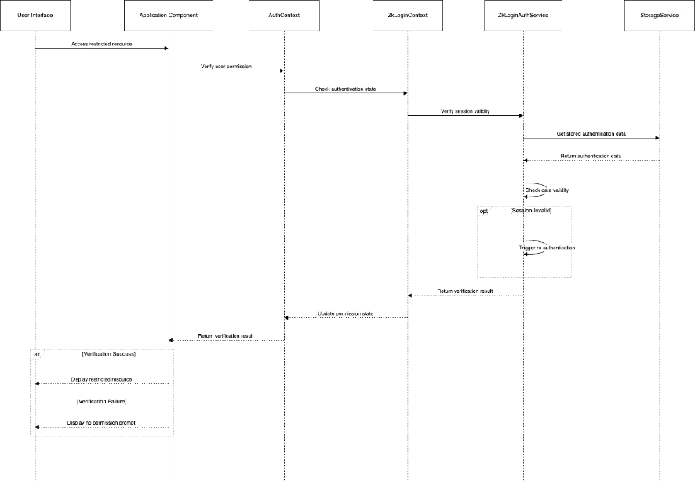
Authentication System-Identity Verification
Involved Modules
State Persistence
Application Components: Any component requiring permission verification
Authentication State: Saved in memory via ZkLoginContext
State Management: AuthContext.tsx, ZkLoginContext.tsx
Session Data: Stored in localStorage, with expiration time
Service: ZkLoginAuthService.ts, StorageService.ts
Permission Information: Briefly saved in memory via AuthContext
Verification Result: Not persisted, verified again when needed

Slide 9



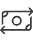

Deposit System
User Deposit
Deposit History
Serves as funding entry point, supporting financial needs of other business modules
Retrieve user deposit records, calculate and display deposit history

Slide 10

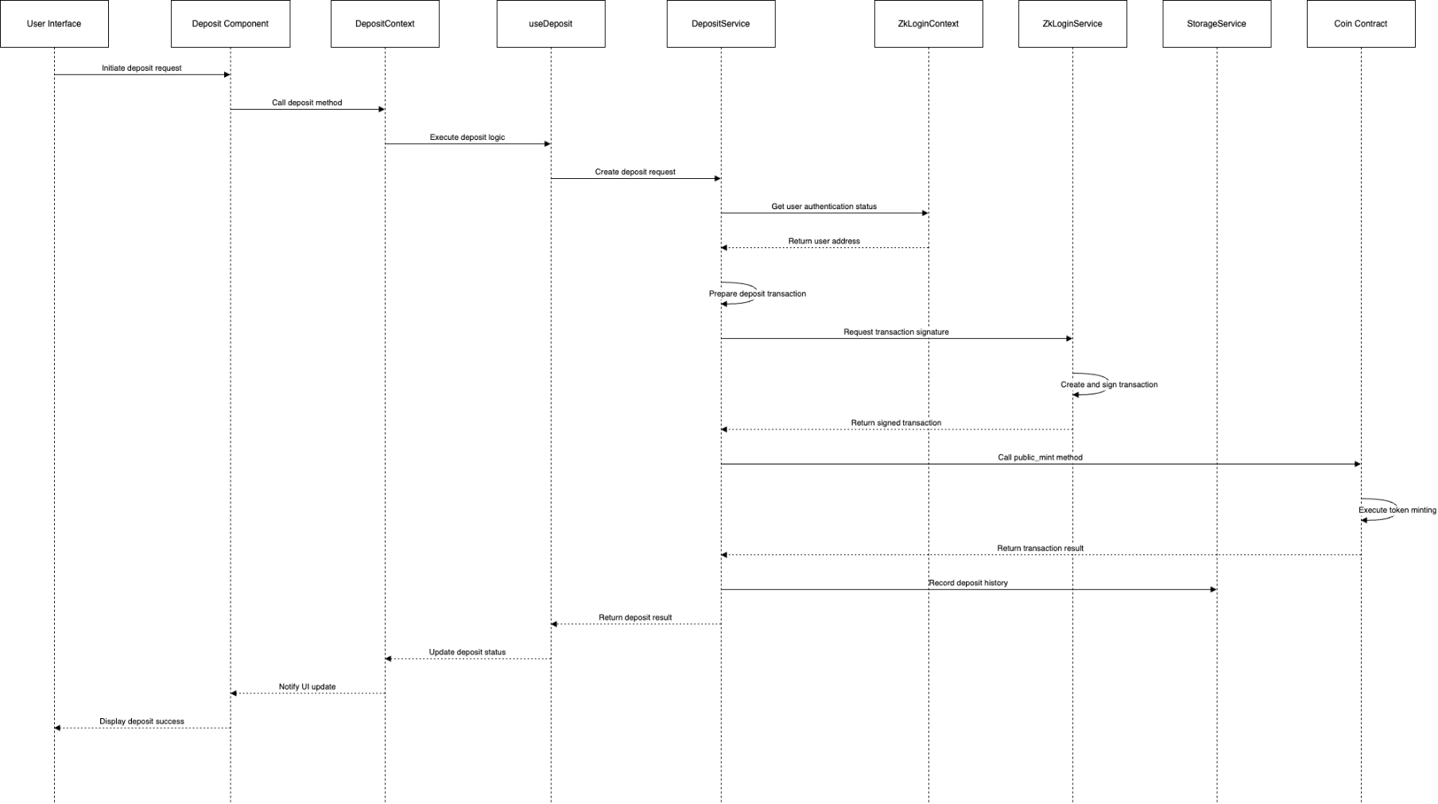
Deposit System-User Deposit
Involved Modules
State Persistence
Frontend Components: /components/deposit/
Deposit request: Temporarily stored in DepositContext memory
State Management: DepositContext.tsx，ZkLoginContext.tsx
User identity data: Stored in ZkLoginContext and localStorage
Business Logic: useDeposit.ts
Transaction data: Temporarily stored in memory
Service: DepositService.ts，ZkLoginService.ts
Minting result: Permanently stored on blockchain
Blockchain Contracts: coin.move
Deposit record: Stored in database and possibly in local cache
User balance: Stored on blockchain, cached in DepositContext

Slide 11

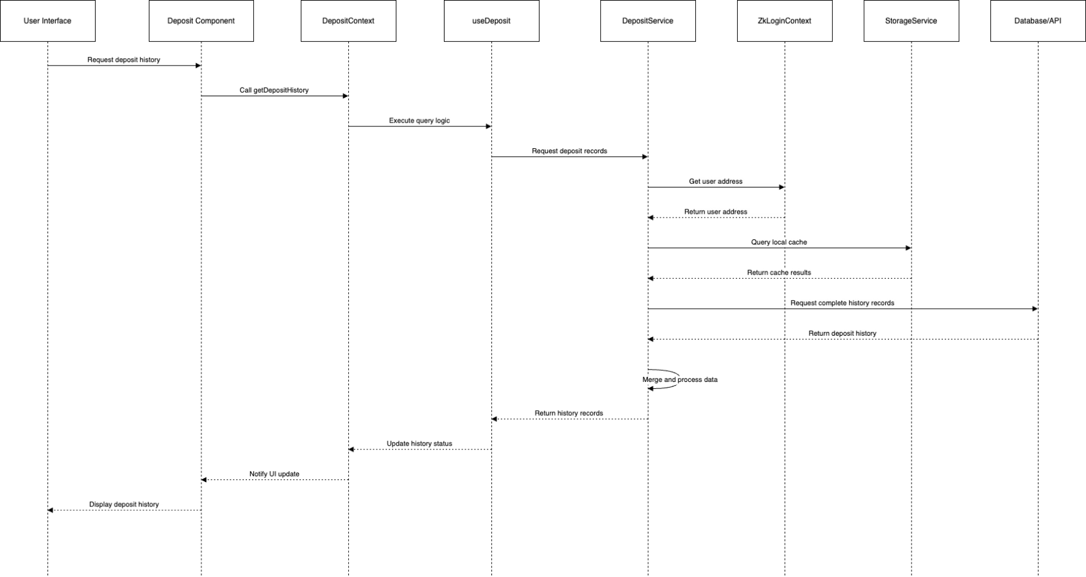
Deposit System-Deposit History
Involved Modules
State Persistence
Frontend Components: /components/deposit/
Query parameters: Temporarily stored in DepositContext memory
State Management: DepositContext.tsx，ZkLoginContext.tsx
User identity: Stored in ZkLoginContext and localStorage
Business Logic: useDeposit.ts
History cache: Possibly stored short-term in localStorage
Service: DepositService.ts，StorageService.ts
Complete history: Stored in backend database or retrieved from on-chain transaction records
Merged data: Temporarily stored in memory
Display data: Cached in DepositContext, possibly saved in sessionStorage

Slide 12


Lottery System
User Lottery
Lottery History
After verifying user identity, provide instant lottery experience
Retrieve user lottery records, calculate and display lottery history

Slide 13

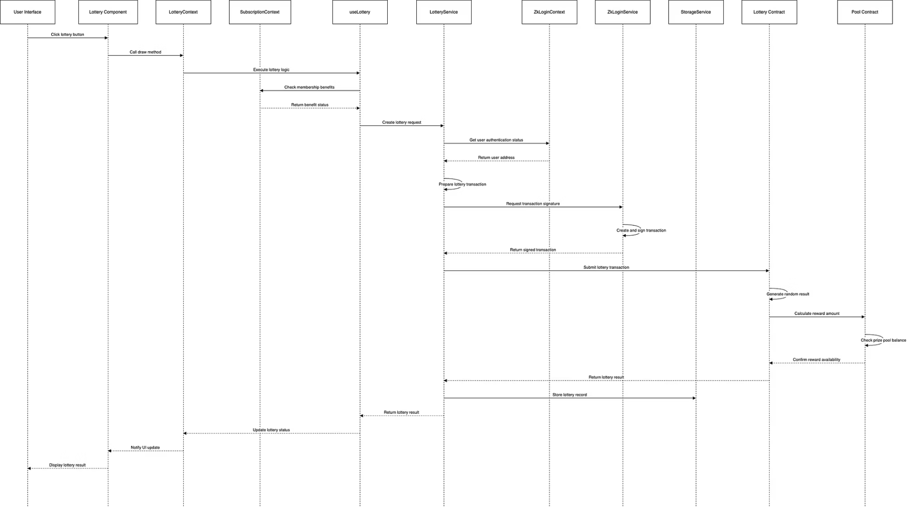
Lottery System-User Lottery
Involved Modules
State Persistence
Frontend Components: /components/lottery/
Lottery request: Temporarily stored in LotteryContext memory
State Management: LotteryContext.tsx, ZkLoginContext.tsx
User identity: Stored in ZkLoginContext and localStorage
Business Logic: useLottery.ts
Lottery transaction: Temporarily stored in memory, eventually stored on blockchain
Service: LotteryService.ts, ZkLoginService.ts
Lottery result: Permanently stored on blockchain
Blockchain Contracts: lottery.move，pool.move
Lottery record: Stored in database and possibly in local cache

Slide 14

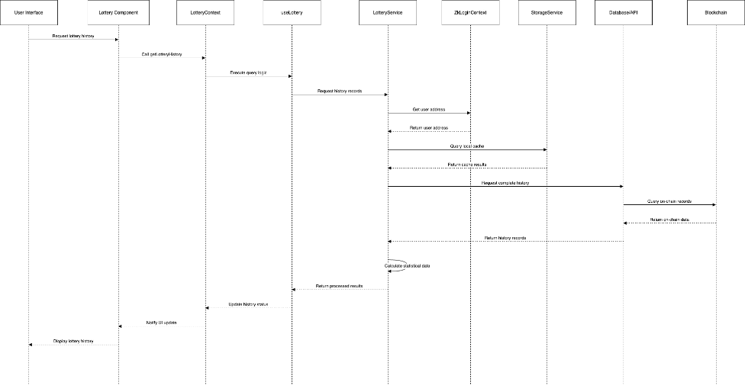
Lottery System-Lottery History
Involved Modules
State Persistence
Frontend Components: /components/lottery/
Query parameters: Temporarily stored in LotteryContext memory
State Management: LotteryContext.tsx，ZkLoginContext.tsx
User identity: Stored in ZkLoginContext and localStorage
Business Logic: useLottery.ts
History cache: Possibly stored short-term in localStorage
Service: LotteryService.ts，StorageService.ts
Complete history: Stored in database and on blockchain
Statistical data: Temporarily calculated, possibly cached in LotteryContext
Display data: Cached in LotteryContext, possibly stored short-term in sessionStorage

Slide 15


Subscription System
Renew Subscription
User renews subscription after expiration
Create Subscription
User creates subscription after selecting a subscription plan
Cancel Subscription
User cancels subscription in advance
3

Slide 16

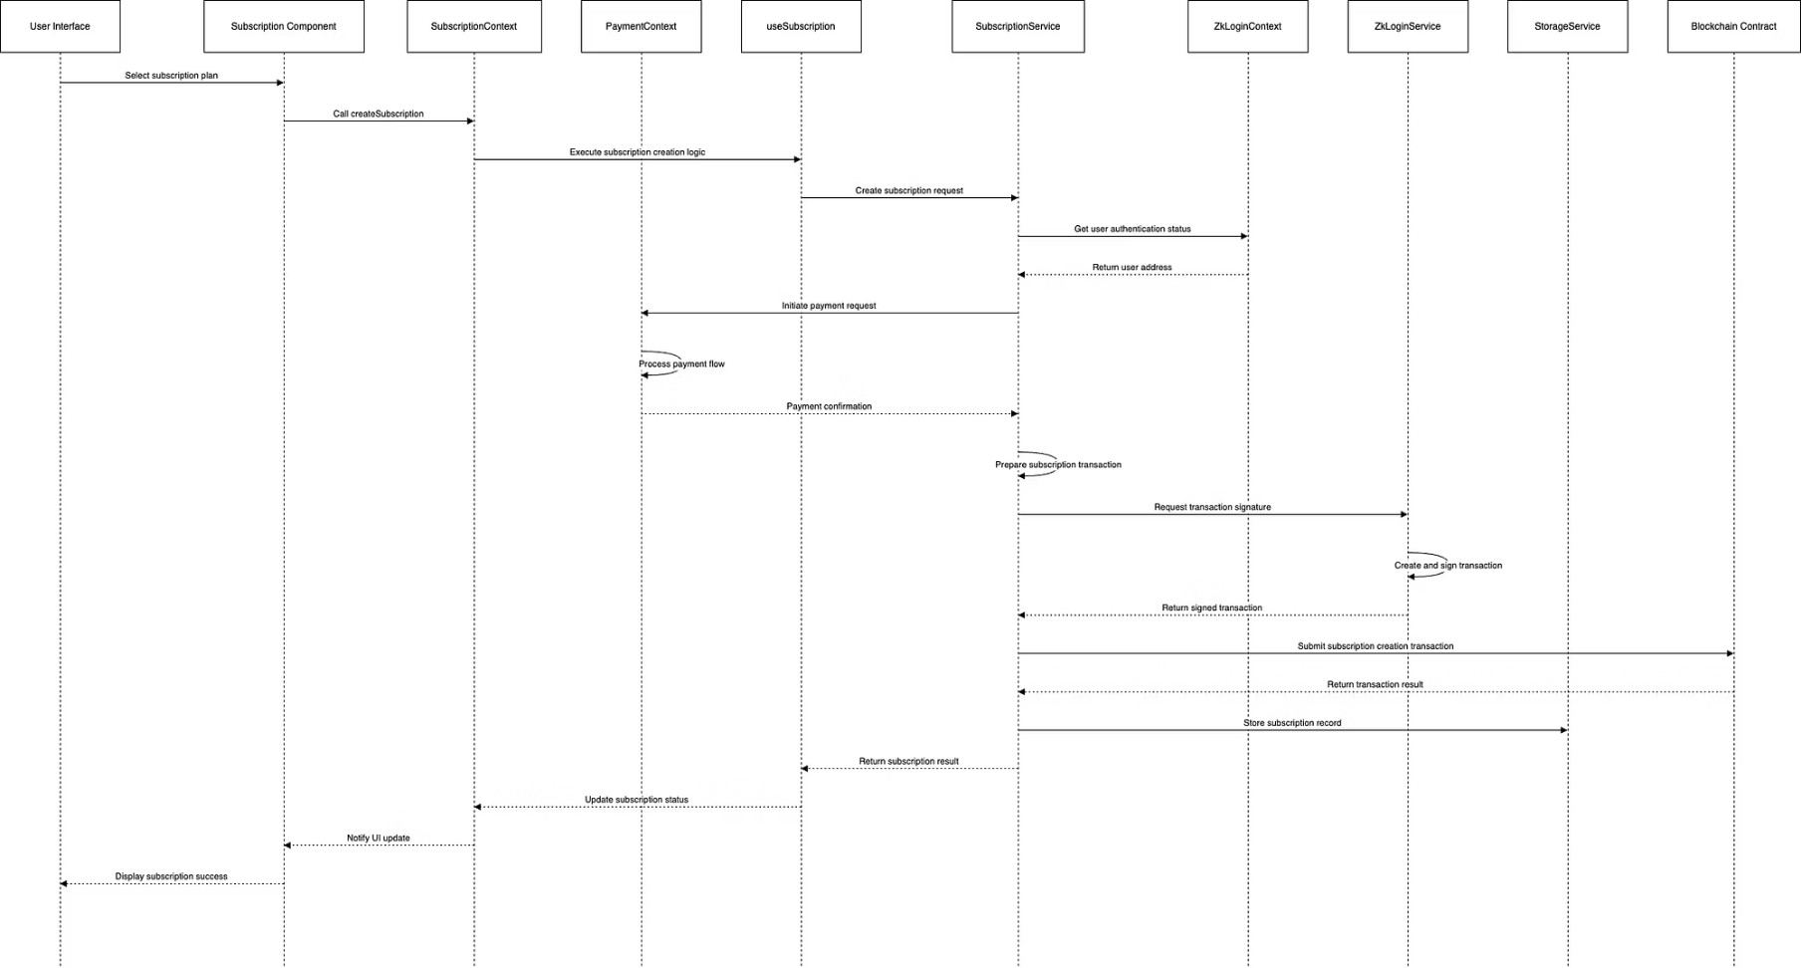
Subscription System-Create Subscription
Involved Modules
State Persistence
Frontend Components: /components/subscription/
Subscription plan data: Temporarily stored in SubscriptionContext memory
State Management: SubscriptionContext.tsx，ZkLoginContext.tsx，PaymentContext.tsx
User identity information: Stored in ZkLoginContext and localStorage
Business Logic: useSubscription.ts
Payment data: Temporarily stored in PaymentContext memory
Service: SubscriptionService.ts，ZkLoginService.ts
Transaction data: Permanently stored on blockchain
Blockchain Contracts: subscription.move，authentication.move
Subscription records: Saved in database and on blockchain
Subscription status: Persisted to localStorage through SubscriptionContext

Slide 17

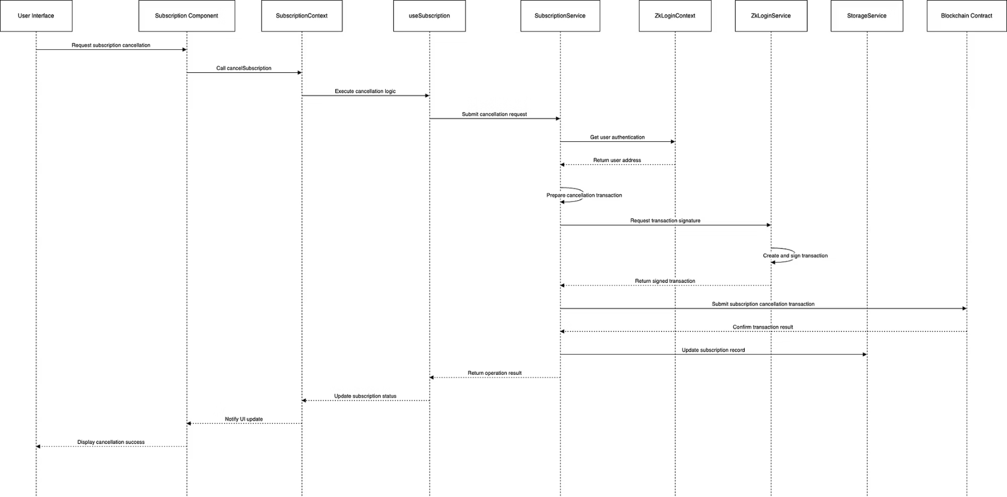
Subscription System-Cancel Subscription
Involved Modules
State Persistence
Frontend Components: /components/subscription/
Cancellation request: Temporarily saved in memory
State Management: SubscriptionContext.tsx，ZkLoginContext.tsx
Authentication data: Stored in ZkLoginContext and localStorage
Business Logic: useSubscription.ts
Transaction result: Permanently saved on blockchain
Service: SubscriptionService.ts，ZkLoginService.ts
Subscription status: Updated in database and localStorage
Blockchain Contracts: subscription.move
Status change: Saved through SubscriptionContext and notified to UI

Slide 18

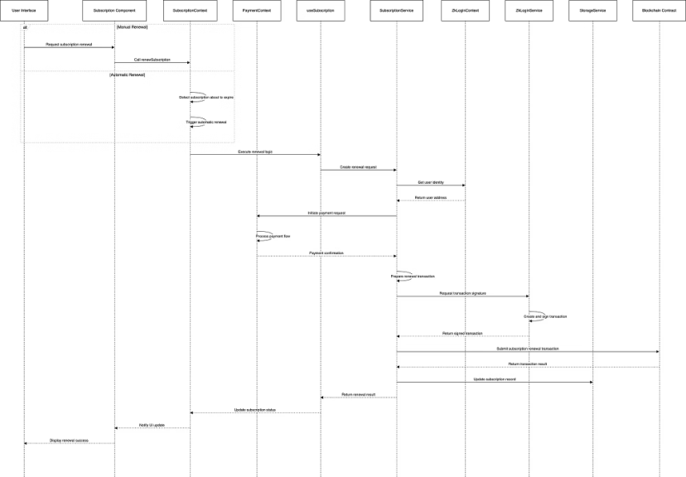
Subscription System-Renew Subscription
Involved Modules
State Persistence
Frontend Components: /components/subscription/
Auto-renewal settings: Saved on blockchain and in local storage
State Management: SubscriptionContext.tsx，PaymentContext.tsx，ZkLoginContext.tsx
Subscription expiration data: Tracked in database and local cache
Business Logic: useSubscription.ts
Payment information: Temporarily saved in PaymentContext memory
Service: SubscriptionService.ts，PaymentService.ts，ZkLoginService.ts
Transaction result: Permanently saved on blockchain
Blockchain Contracts: subscription.move，fund.move
Subscription status: Updated in database, local storage, and SubscriptionContext
Operation records: Possibly recorded in logs and on blockchain

Slide 19
Key Challenges and Achievements
Achievements
Challenges
zkLogin technology exploration
User details page
Layered architecture design practice
Real payment integration
Vercel deployment
User growth mechanisms
Supabase integration
More OAuth integrations

Slide 20

Q&A

